Slide 1
Role of women in early REDD+ implementation
Anne Larson, Amy E. Duchelle Therese Dokken,
Andina Auria Dwi Putri
COP21 Gender Day - Paris, France - 09 December 2015
a.duchelle@cgiar.org

Slide 2
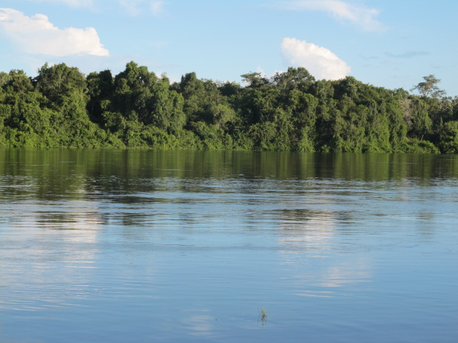
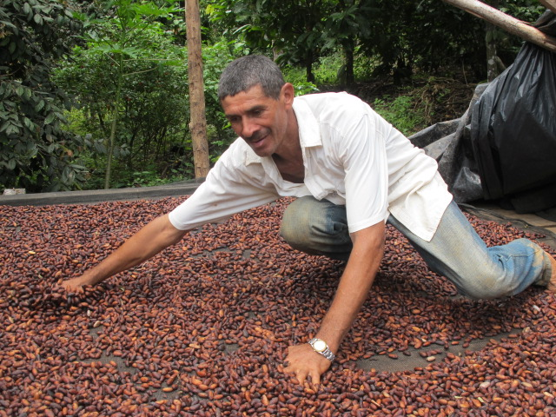
Emergence of subnational REDD+ initiatives
Since 2007, hundreds of subnational REDD+ initiatives have emerged in the tropics
On-the-ground evidence for how local people could benefit or lose from REDD+, particularly in relation to respect for local rights, participation and enhancement of livelihoods

Slide 3
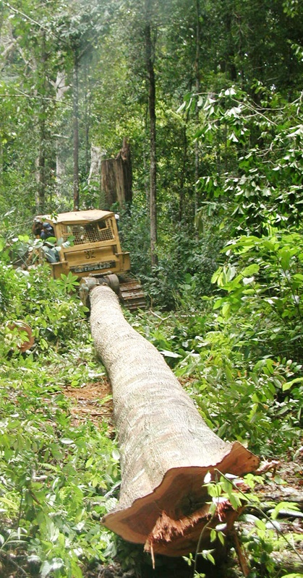
CIFOR’s Global Comparative Study: GCS-REDD+
To support REDD+ policy arenas and practitioner communities with:
information
analysis
tools
To promote 3E+ outcomes:
effectiveness
efficiency
equity and co-benefits

Slide 4
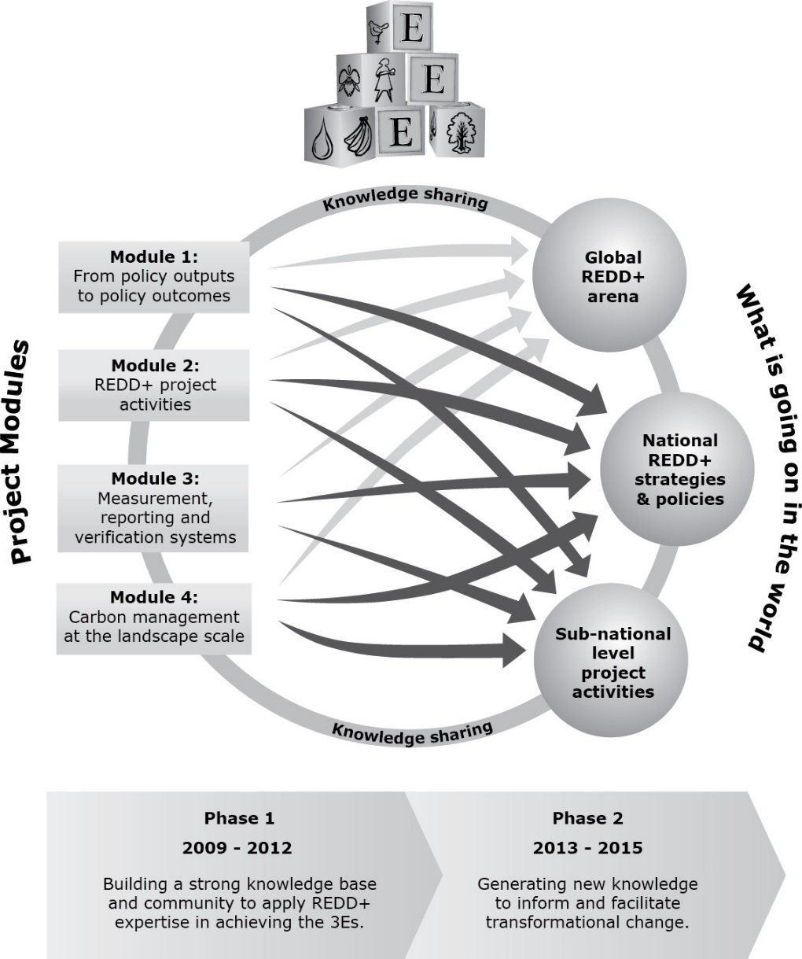
GCS Structure
REDD+ policies and processes (M1)
Subnational REDD+ initiatives (M2)
Monitoring and reference levels (M3)
Carbon in the landscape and multilevel governance (M4)
Knowledge sharing (M5)

Slide 5
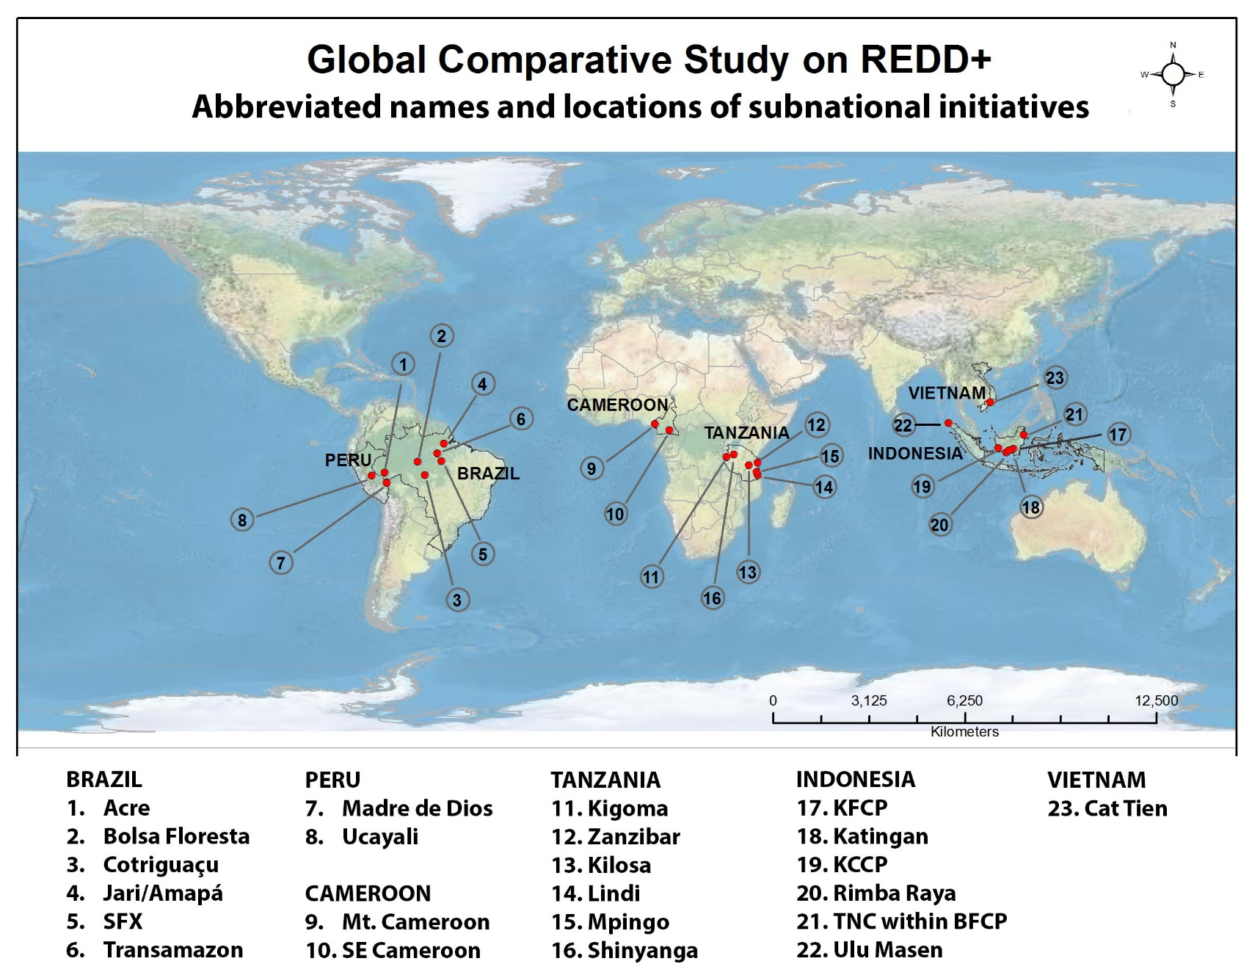
6 countries - 22 sub-national REDD+ initiatives
150 villages – 4,000 households

Slide 6
Subnational REDD+ Initiatives (GCS M2)
Through its BACI method, M2 will provide empirical evidence of what is succeeding and failing in REDD+ with respect to effectiveness, efficiency, equity, and co-benefits (livelihoods, governance, biodiversity)
Comparison (Control)
REDD+ site (Intervention)
 | Before | After
Control
Before
Control
After
IMPACT
Intervention
Before
Intervention
After
2010 / 2011
2013 / 2014

Slide 7
Mix of forest interventions at REDD+ sites

Slide 8
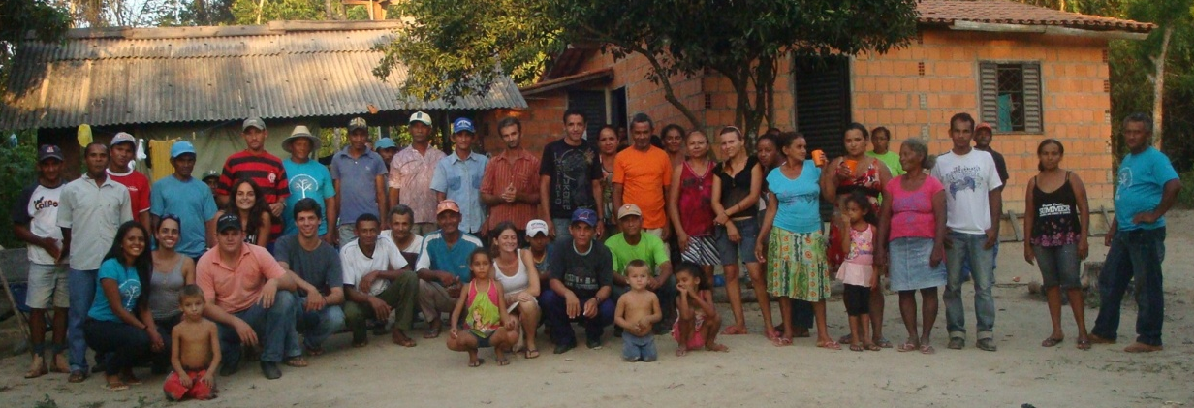
Local participation in REDD+
Notes:
Improved local knowledge of initiatives – especially among women’s groups and households at the study sites – but participation in REDD+ still lacking, especially among women

Slide 9
Local perceptions of forest interventions in Brazil

Slide 10
Conclusions
Improved local knowledge of initiatives, but participation in REDD+ still lacking, especially among women
Women’s wellbeing may have been more negatively impacted by forest interventions in Brazil – need to understand reasons behind the responses
Need for gender-disaggregated data in impact evaluations. Interventions that do not seek to address imbalances at the outset may be doomed to perpetuate them.

Slide 11
Financial support for GCS-REDD+:
Norwegian Agency for Development Cooperation,
Australian Agency for International Development,
European Commission,
UK Department for International Development,
CGIAR Forests, Trees and Agroforestry (FTA) Programme.
Global Comparative Study on REDD+: http://www.cifor.org/gcs/
Forests and Gender: http://www.cifor.org/gender/

